Slide 1
Introducing Family Safe 2013
A functional tour

Slide 2
FamilySafe
Use cases
Emergency Preparedness
Convergent meetings
Safer and faster communication between travelers
Child or driver tracking
Location Updates
Destination Sharing
SMS Voice Messages
Conference using RTC

Slide 3
Who will use this?
Parents to make sure their kids are not deviating from safe locations
Parents who shuttle their children
Groups travelling
Commuters – Save time

Slide 4
FamilySafe
Location Sharing
Destination Sharing
SMS Voice Messaging
One-touch Conference calls

Slide 5
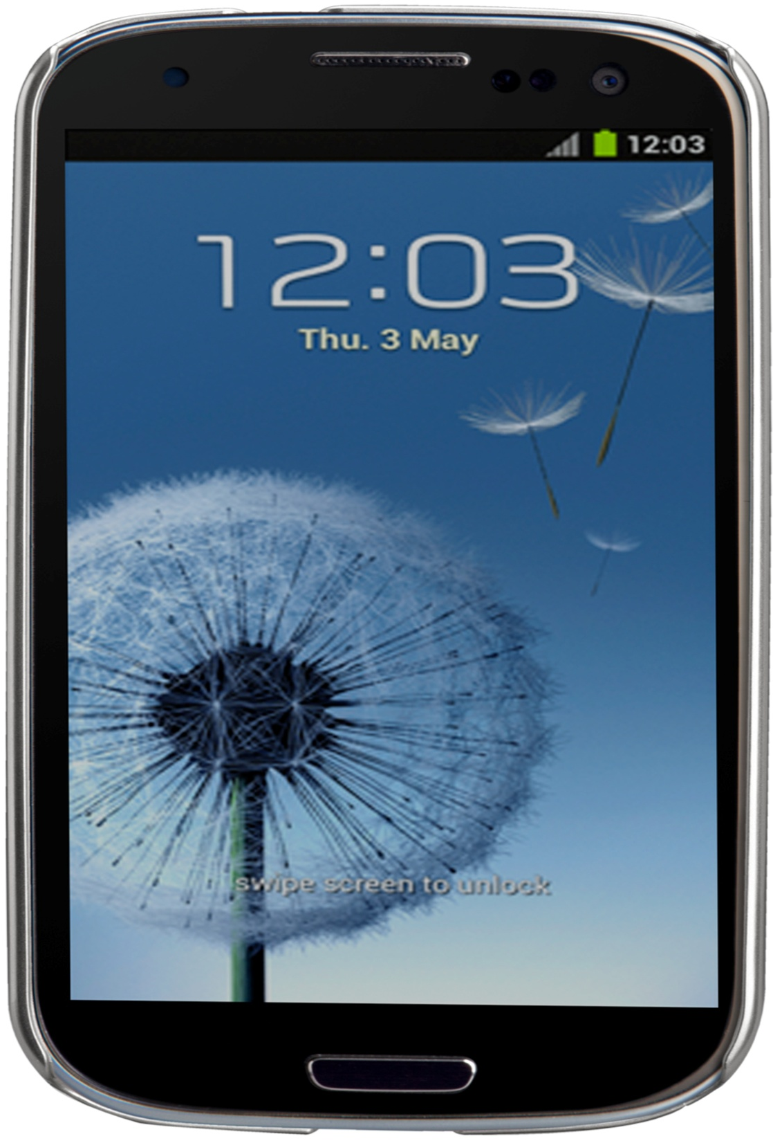
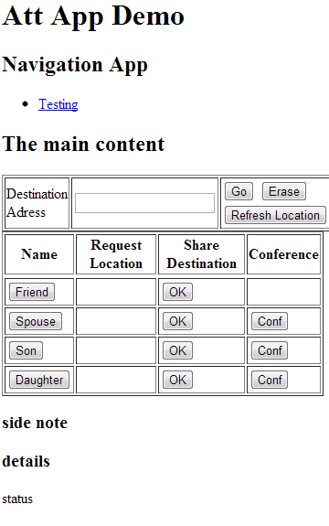
45 Fremont ca 98456
In Las Vegas

